Slide 1
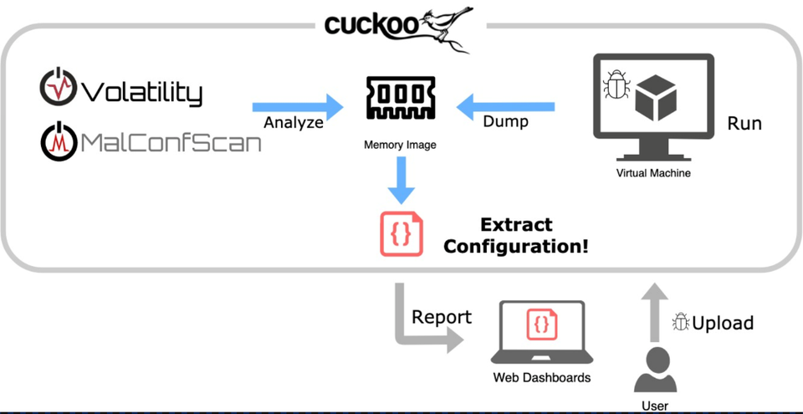

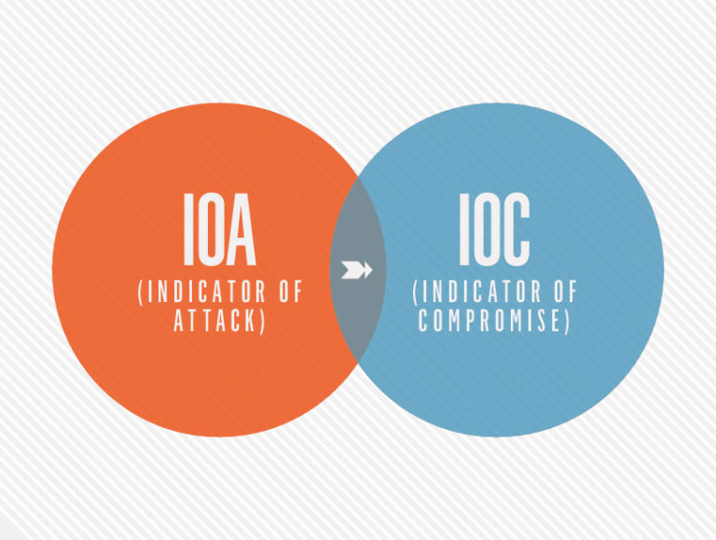
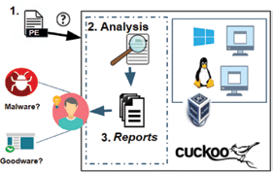
CYBERSECURITY
Cuckoo A Open Source

Slide 2
Week-1

Slide 3
What is Cuckoo?
A Cuckoo Sandbox is an open source tool that creates an illusion server just like the host server and launches malware into that mirror server; the idea behind this is that sandbox fools the malware into thinking it has infected a genuine host.
The sandbox then records the activity of the malware and then generates a report on what the malware has attempted to do and gathers IOC’s which gives a quick and detailed information about how malware behaves.
Cuckoo Sandbox started as a Google Summer of Code project in 2010 within The Honey net Project.

Slide 4

What is IOC ?
Indicators of compromise (IOCs) refer to data that indicates a system may have been infected by a cyber threat. They provide cyber security teams or SOCs(Security Operations Center) with crucial knowledge after a data breach or another breach in security.
An IOC is the cyber-equivalent of evidence left at a crime scene. They're essentially digital versions of tire tracks, fingerprints, and broken windows

Slide 5
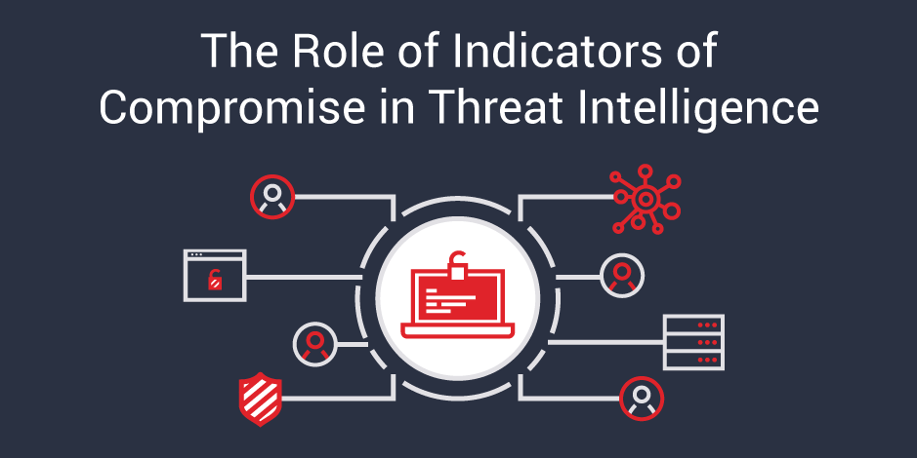
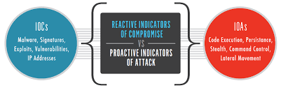
Types of IOCs
Unusual Network Traffic
Privileged User Logins from Foreign Countries
Strange DNS Requests
System File Changes
Use of a Suspicious Application Programming Interface (API)

Slide 6
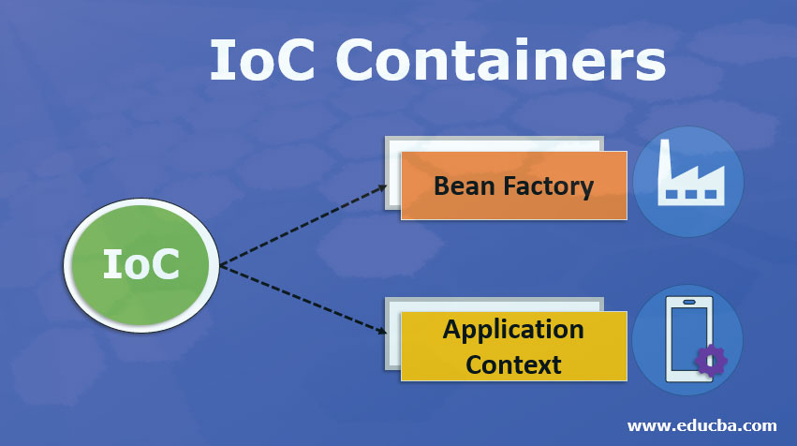
IOC vs IOA
Indicators of attack (IOA) focus on detecting the intention of an attacker that he is trying to accomplish, regardless of the malware or exploit used in an attack.
Indicator of Compromise (IOC) gathers the evidence that some security breach has been done so that smarter tools can be made to detect that malicious file in future.
Cuckoo Sandbox is based on IOC but next generation tools need IOA to reduce security breach.

Slide 7
IOA Working Model ?
So suppose a robber tried for bank robbery and succeeded so IOA will gather information like he parked the car then enters the bank then tried to open the vault. That is makes a report on all the actions he performed so that in future the security team becomes alert if somewhat happens like this.
Whereas IOC will give info of what a CCTV will give like clothes of robber, what he has used to open the vault, etc. But by this we can’t stop it in future maybe someone with different car or clothes can rob bank again.
Making it to cyber most prominent threat is phishing so actions like clicking on a random mail and download of a file and then that malware will approach to control and command panel to execute and steal confidential information.

Slide 8
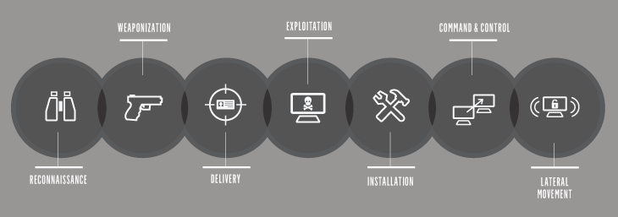
Model of IOA

Slide 9
What is Sandbox?
In computer security, a sandbox is a security mechanism for separating running programs. It is often used to execute untested code, or untrusted programs from unverified third-parties, suppliers, untrusted users and untrusted websites.
This concept applies to malware analysis’ sandboxing too: our goal is to run an unknown and untrusted application or file inside an isolated environment and get information on what it does.
Malware sandboxing is a practical application of the dynamical analysis approach: instead of statically analyzing the binary file to get evidences, it gets executed and monitored in real-time GUI.

Slide 10
Advantages Vs Disadvantages
Advantages :
Cuckoo is open source and free to download and works identical to paid versions like McAfee
Generates IOC that gives detailed information about the threat.
Disadvantages:
Its is quite complicated and time consuming to download as it need many dependencies.
It works on IOC (previous vision) not on IOA.

Slide 11
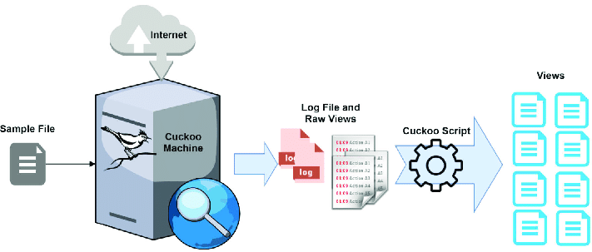
Systems Cuckoo can Work Upon?
It can be used to analyze:
Generic Windows executable
DLL files
PDF documents
Microsoft Office documents
URLs and HTML files
PHP scripts
CPL files
Visual Basic (VB) scripts
ZIP files
Java JAR
Python files

Slide 12
Cuckoo Components?
The main components of Cuckoo’s infrastructure are an Host machine (the management software) and a number of Guest machines (virtual or physical machines for analysis).
The Host runs the core component of the sandbox that manages the whole analysis process, while the Guests are the isolated environments where the malware samples get actually safely executed and analyzed.
Cuckoo makes a detailed report and sent back to the host server.

Slide 13
What can Cuckoo Do?
Trace API calls and general behavior of the file and distill this into high level information and signatures comprehensible by anyone.
Dump and analyze network traffic, even when encrypted with SSL/TLS. With native network routing support through InetSIM, a network interface, or a VPN in PCAP format
Perform advanced memory analysis of the infected virtualized system through Volatility as well as on a process memory granularity using YARA.
Files being created, deleted and downloaded by the malware during its execution.
Screenshots taken during the execution of the malware.
Full memory dumps of the machines.

Slide 14
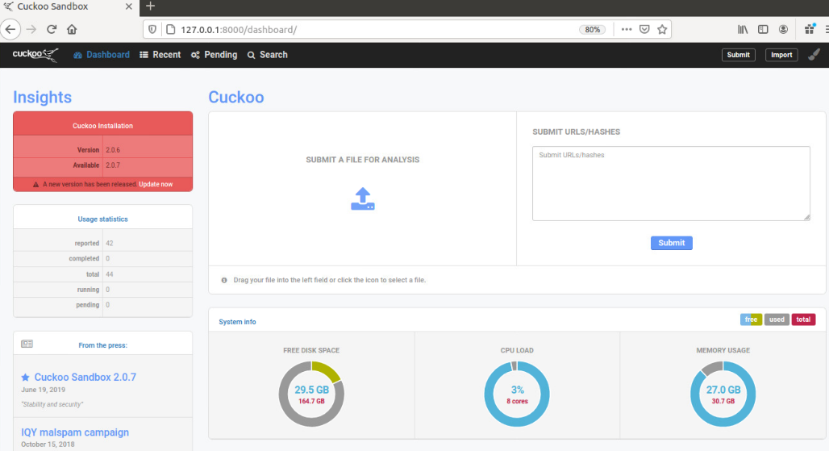
Cuckoo Model
Prepare Host
Ubuntu Download
Virtual box Download
Python Libraries
TCP Dump
Volatility
M2Crypto
GUACD
Cuckoo Install
Prepare Guest (Windows 10)
Virtual Machine
Python Install
Python Pillow
Virtual Networking
Cuckoo Agent
Clone Virtual Machine
Launching
Malware file
Reports
Analyze
Working Directory And Network Routing

Slide 15
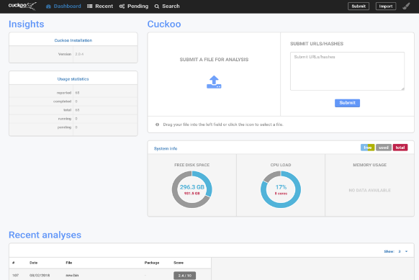

Cuckoo Working Directory?
Configuration
Cuckoo Signatures
Cuckoo Analyzer
Cuckoo Agent
Yara rules
Cuckoo Storage (shows analysis results)
conf. This file allows you to enable, disable and configure all processing modules. These modules are located under the cuckoo.
cuckoo.conf: for general behavior and analysis
<machinery>.conf: showing options of virtualization software
memory.conf: Volatility configuration.
reporting.conf: for enabling or disabling report formats.

Slide 16
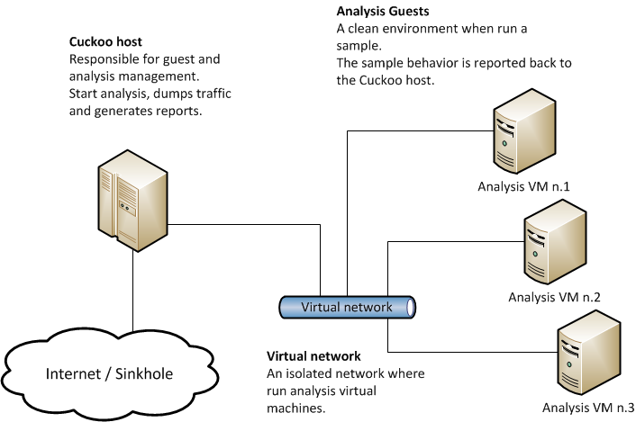
Machinery Modules (under config)
This option defines which Machinery module you want Cuckoo to use to interact with your analysis machines. The value must be the name of the module without extension (e.g. Virtual box or VMware).
Oracle VM Virtual Box is cross-platform virtualization software. It allows users to extend their existing computer to run multiple operating systems including Microsoft Windows, Mac OS X, Linux, and Oracle Solaris, at the same time.
Whereas my Host Server is Ubuntu 22 .0 version (Ubuntu is a Linux distro based on Debian. It is suitable for cloud computing, servers, desktops, and internet of things (IoT) devices).

Slide 17
Volatility Configuration ?
The Volatility Framework is a open source of tools, implemented in Python, analysts use this for extracting artifacts from memory dumps of (RAM).
Volatility Workbench is a graphical user interface (GUI) for the Volatility tool. Volatility is a command line memory analysis of memory dumps that indicates data breach.
A memory dump is the process of taking all information of RAM and copying it to a storage drive as a memory dump file.
Developers commonly use memory dumps (also called core dumps) to gather diagnostic information at the time of a crash that tells about the event. Information gathered from the memory dump can help developers fix errors in operating systems and other programs of all kinds.

Slide 18
Points To Search Upon:
Parameters Cuckoo Work Upon
GUARD and M2Crypto (Web Design/server host)
Cuckoo Signatures
Cuckoo Analyzer
Cuckoo Agent
YARA Framework
Python Pillow
About Web interface
PE Studio
Network Routing (TCP Dump/ TOR/ VPN)

Slide 19
Week-2

Slide 20
Parameters Used by Cuckoo
Some of the parameters and techniques used by cuckoo sandbox for malware detection and analysis include:
Behavioral Analysis
Network Traffic Analysis
Static Analysis
Dynamic Analysis
Signature-based Detection
Heuristics and Machine Learning
By combining these techniques, cuckoo sandbox provides an automated and comprehensive analysis of files, helping in the detection and identification of malware.

Slide 21
Behavioral & Network Traffic Analysis
Cuckoo sandbox monitors the behavior of the file, such as file system activity, network traffic, process monitoring, and registry changes. It checks for suspicious activities that could indicate the presence of malware.
Cuckoo sandbox captures and analyzes network traffic generated by the file being analyzed. It can detect communication with known malicious IP addresses or domains, abnormal network behavior, or connections to known command-and-control servers.

Slide 22
Static & Dynamic Analysis
3. Cuckoo sandbox performs static analysis on the file without executing it. It examines the file's structure, metadata, and characteristics to identify potential indicators of malware, such as malicious signatures, packer or obfuscation techniques, or suspicious code patterns.
4. Cuckoo sandbox executes the file in a controlled environment and monitors its runtime behavior. It analyzes system calls, API interactions, and other runtime events to identify any malicious or suspicious actions performed by the file.

Slide 23
Signature-based Detection & Heuristics and Machine Learning
5. Cuckoo sandbox can compare the file against a database of known malware signatures. If the file matches any known signatures, it indicates the presence of malware.
6. Cuckoo sandbox may employ heuristics and machine learning techniques to identify potentially malicious behavior based on patterns, anomalies, or statistical models. This approach helps detect new or unknown malware that may not have specific signatures.

Slide 24
GUARD and M2Crypto
GUARD is a web application security library developed by the (OWASP). It stands for "Generalized Architecture for Dynamic Infrastructure Defense" and aims to provide a comprehensive set of security controls and mechanisms to protect web applications from various types of attacks, including injection attacks, cross-site scripting (XSS), cross-site request forgery (CSRF), and more.
M2Crypto is a Python library that provides cryptographic and SSL/TLS functionalities. It allows developers to incorporate encryption, digital signatures, SSL/TLS protocols, and certificate management into their Python applications. M2Crypto is built on top of OpenSSL, which is a widely used open-source cryptographic library. With M2Crypto, developers can secure communication channels, perform secure data encryption and decryption.

Slide 25
Cuckoo Signatures & Analyzer
Cuckoo Signatures are a set of rules or patterns used by Cuckoo Sandbox to detect specific behaviors of malware or suspicious files. These signatures are similar to antivirus signatures or indicators of compromise (IOCs). They can be based on various attributes, such as file hashes, network connections, API calls, registry modifications, or other behavioral patterns.
The Cuckoo Analyzer is a core component of Cuckoo Sandbox responsible for analyzing and extracting information from the submitted files. It employs various techniques, such as behavioral analysis, network traffic monitoring, dynamic and static analysis, to gain insights into the file's behavior and potential malicious activities. It facilitates the identification and classification of malware.

Slide 26
YARA Framework
The YARA framework is an open-source tool used for malware identification and classification. It stands for "Yet Another Recursive Acronym." It allows security researchers, malware analysts, and incident response teams to create custom rules to identify and categorize files based on specific patterns, strings, or behavioral characteristics.
These rules can include strings, regular expressions, Boolean logic operators, and metadata.
The YARA framework consists of two main components:
YARA Rule Compiler
YARA Engine

Slide 27
Python Pillow & PE Studio
Pillow is a popular open-source Python library used for image processing and manipulation. It serves as a powerful tool for working with images in various formats, including opening, saving, modifying, and enhancing images. Pillow provides a wide range of functionalities such as resizing, cropping, rotating, filtering, adding text or shapes, and applying various image effects.
PE Studio is a commercial software tool used for analyzing and examining Windows executable files, specifically Portable Executable (PE) files. PE files are the binary file format. It helps in the analysis of PE files to identify potential security risks, malware. It provides detailed information about the file's structure, dependencies, imported and exported functions and other attributes.

Slide 28
Network Routing - TCP Dump/ TOR/ VPN
Network routing is the process of determining the path that network traffic should follow from its source to its destination across an interconnected network. It involves making decisions at routers and switches to forward packets based on routing tables and protocols.
TCP dump is a command-line packet sniffing tool used to capture and analyze network traffic in real-time. TCP dump captures packets at the operating system level, providing detailed information about the source and destination IP addresses, protocols, ports, packet payloads, and other relevant data. It is commonly used for network troubleshooting, network security analysis, and protocol debugging.

Slide 29
Network Routing - TCP Dump/ TOR/ VPN
TOR (The Onion Router): TOR is a free and open-source software project that enables anonymous communication over the internet. It create a layered and encrypted network path, thereby anonymising the origin and destination of internet traffic. TOR helps protect user privacy by concealing their IP addresses.
VPN (Virtual Private Network): It is a technology that creates a secure and encrypted connection between a user's device and a remote network or server. It allows users to establish a private and encrypted tunnel over a public network, such as the internet. VPNs are commonly used to enhance privacy, secure data transmission.

Slide 30
Alternatives to Cuckoo Sandbox
Joe Sandbox: It is a comprehensive malware analysis platform that offers both static and dynamic analysis capabilities. It provides a range of features, including behavior analysis, code emulation, network traffic analysis, and detection of advanced threats.
Hybrid Analysis: It is an online malware analysis service that allows users to submit files and URLs for analysis. It combines both static and dynamic analysis techniques to provide insights into the behavior of the submitted samples.
Any. Run: It is a cloud-based malware analysis platform that focuses on dynamic analysis. It enables users to interact with malware samples in a controlled environment, observing their behavior in real-time.

Slide 31
Alternatives to Cuckoo Sandbox
VMRay: It is a powerful malware analysis platform that leverages virtual machine introspection (VMI) technology to analyze the behavior of malware. It offers a combination of static, dynamic, and memory analysis techniques to provide deep insights into malware capabilities.
Deep Instinct: It is an advanced endpoint protection solution that incorporates deep learning and artificial intelligence for malware detection and prevention. It offers real-time analysis of files and processes, leveraging a deep neural network to identify and block malicious behavior at the endpoint level.

Slide 32
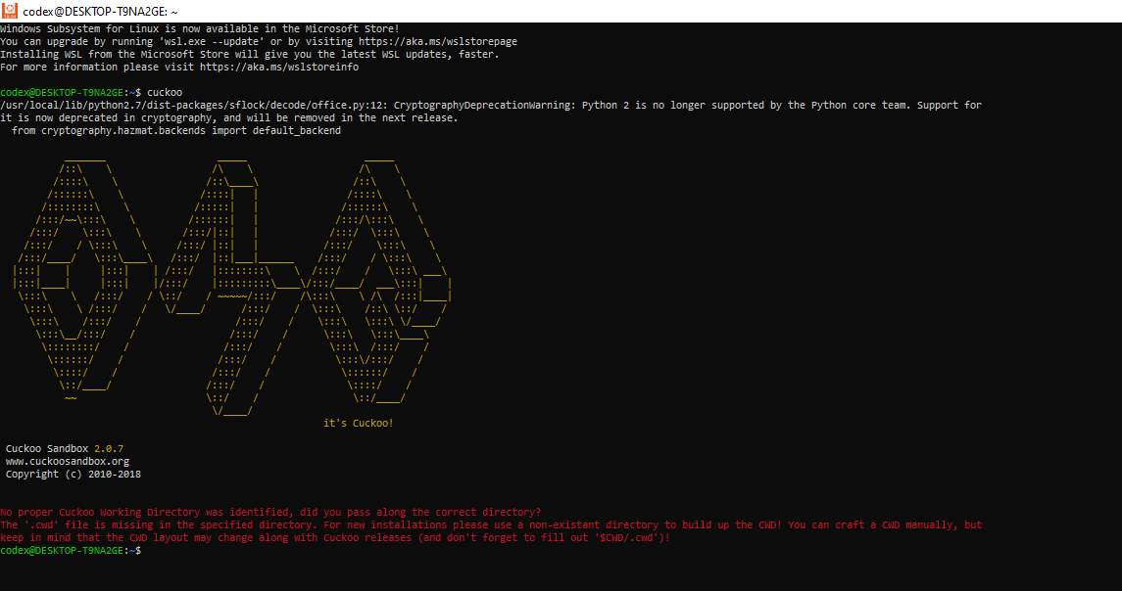
Installation Update

